Slide 1
Prikazivanje i analiza podataka
By Janko sobota & karlo cavor

Slide 2
5 Seconds of Summer
Anja

Slide 3
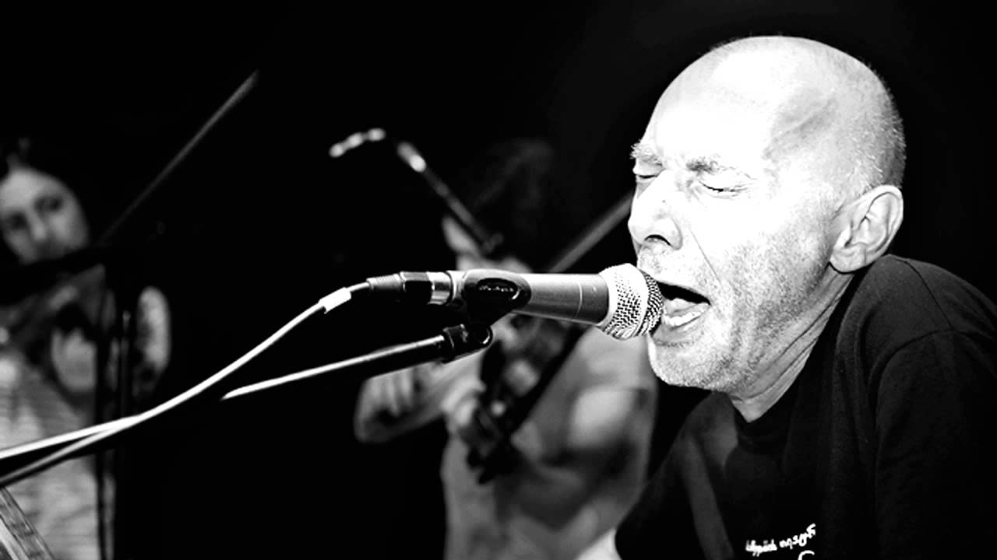
Outsider
Nika

Slide 4
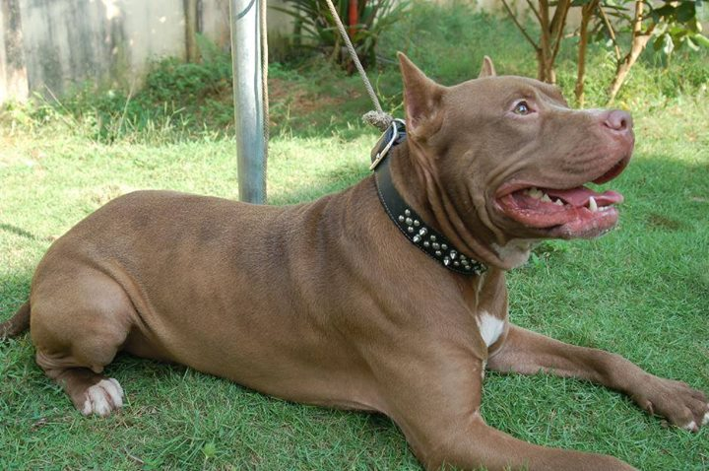
Pitbull
Patrik

Slide 5
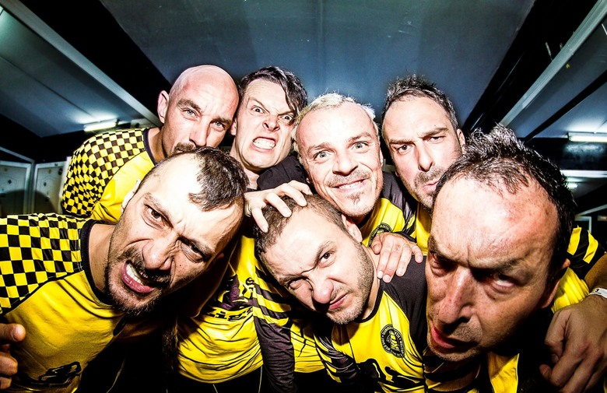
Dubioza Kolektiv
Janko i Karlo

Slide 6
KSI
Juraj

Slide 7
Conor Maynard
Mila

Slide 8
Lidia Bačić
Max, Vito i Fran

Slide 9
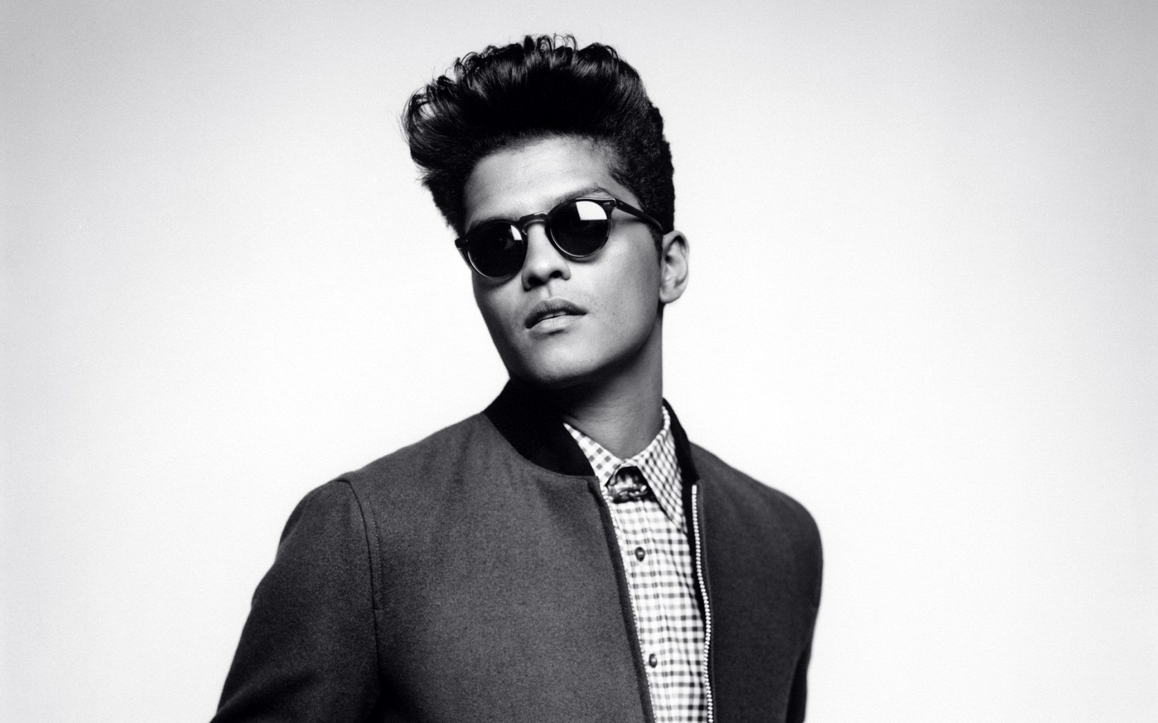
Bruno Mars
Mihael

Slide 10
Timmy Trumpet
Jan i Noa

Slide 11
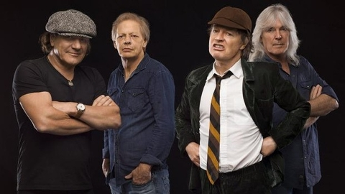
ACDC
Patricia

Slide 12
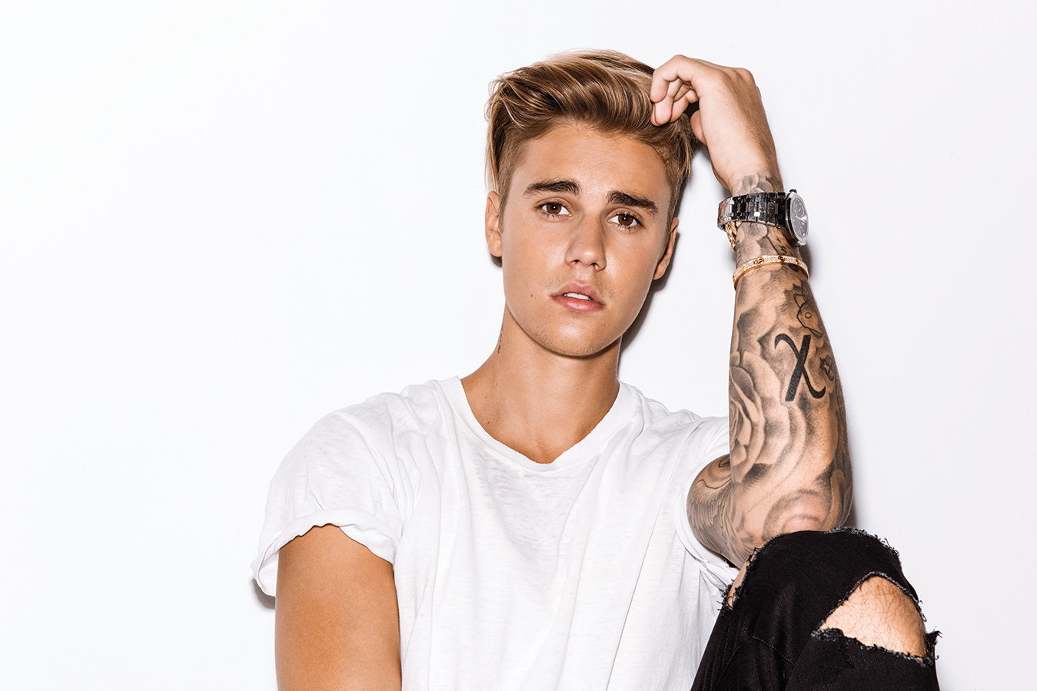
Justin Bieber
Tara, Beata, Mirta, Roberta, Livia, Marko i Jona

Slide 13
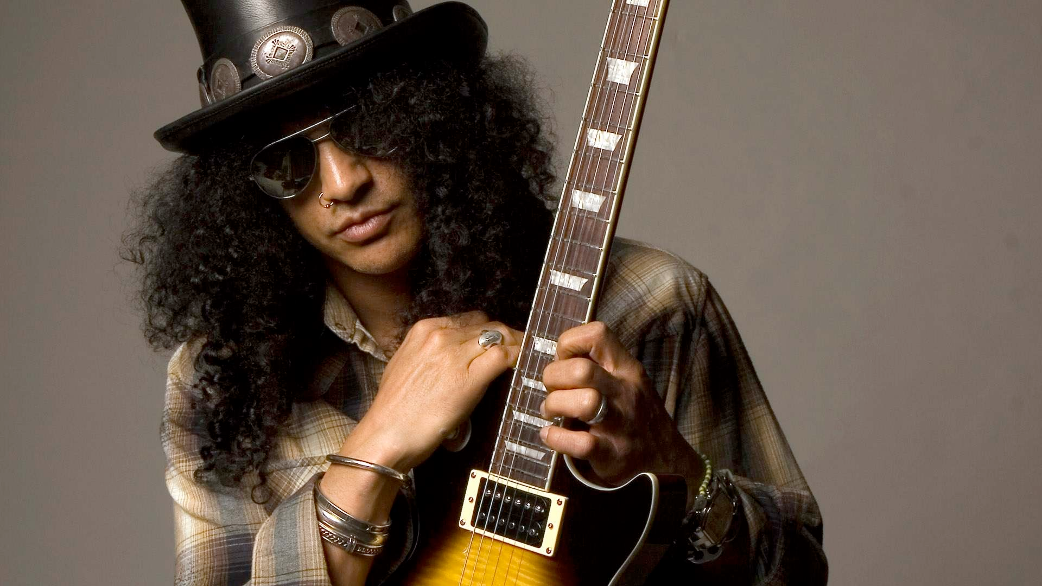
Guns n’Roses (Slash)
Tea

Slide 14
Red Hot Chilli Peppers
Lorena

Slide 15
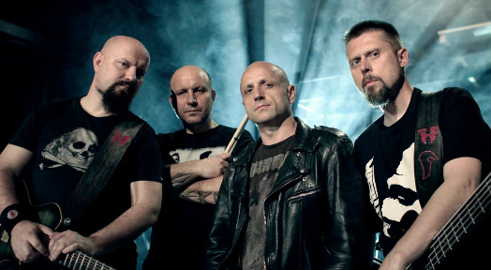
Hladno Pivo
Lovro

Slide 16
Dijagram

Slide 17
A sada za kraj nama najdraže

